Slide 1

A ROMANO-BELGIAN SHEET METAL COMPANY
IN SIBIU (Hermannstadt)-Romania
124 STRADA STEFAN CEL MARE
TEL: +40 762 009938 Email: office@totallaser.eu
Website: www.totallaser.eu

Slide 2
Who are we and where
We are a sheet metal company located in Sibiu-Hermannstadt
We are in a central location in Romania connected to the European motorway network
The Belgian-Romanian company was founded 2017
The turnover is in constant progress: 1.2 million Euros in 2021
We employ 17 people to provide a complete range of services from laser cutting to bending, welding, sandblast, painting and assembling in our 1400 m² premisses
Our staff is able to skillfully engineer your ideas from drawing down to your finished product

Slide 3
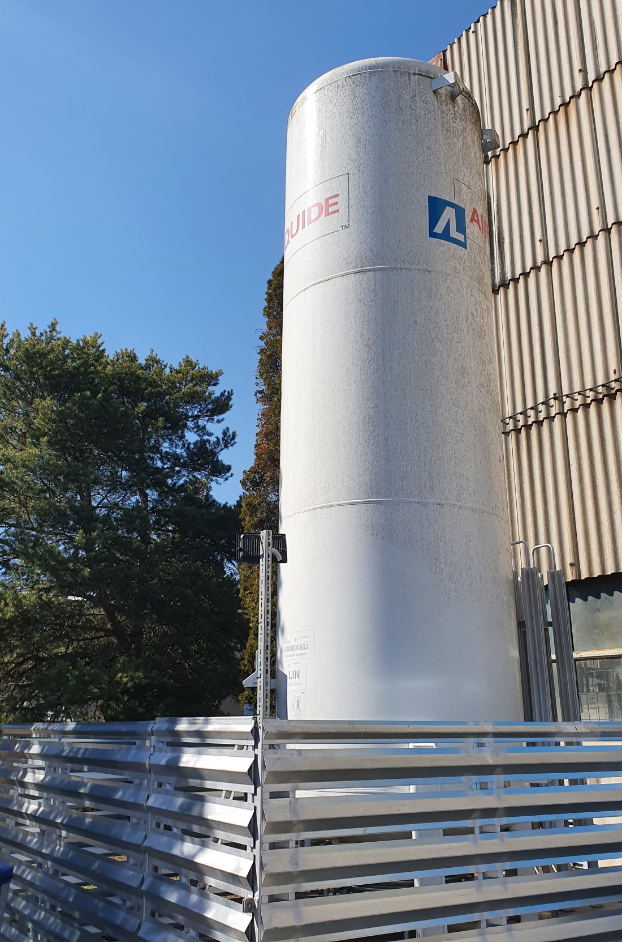
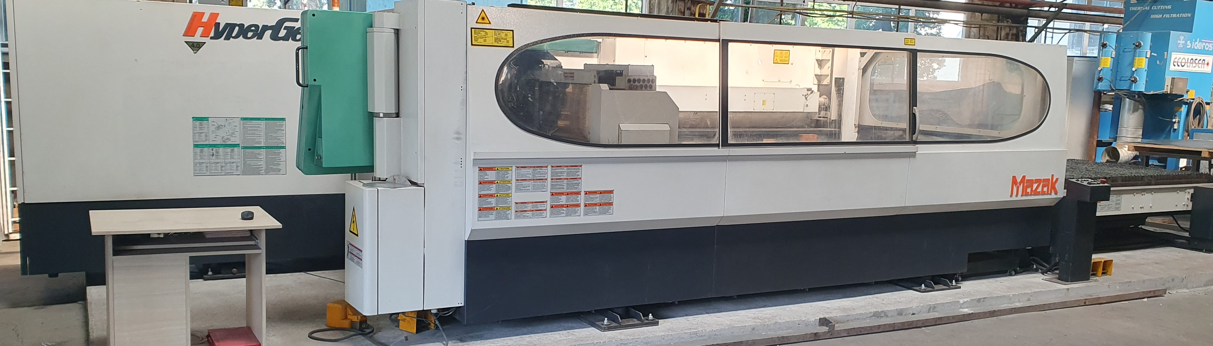
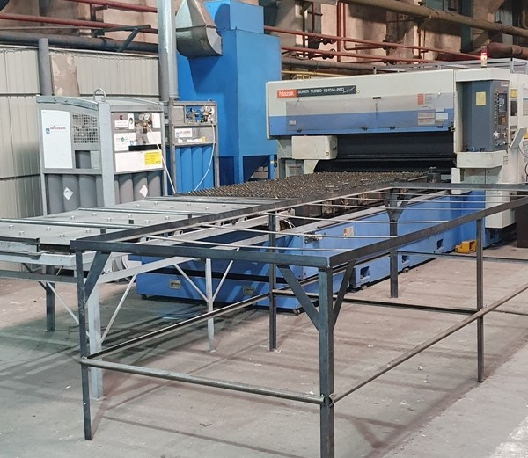
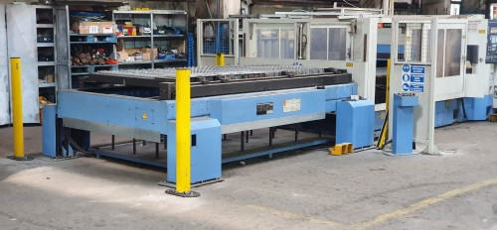
The laser cutting department
The laser cutting machines:
1 laser 2500 watts sheet: 6 M by 1.5
2 laser 4000 watts equiped with pallet changer sheet 3 M x 1.5

Slide 4
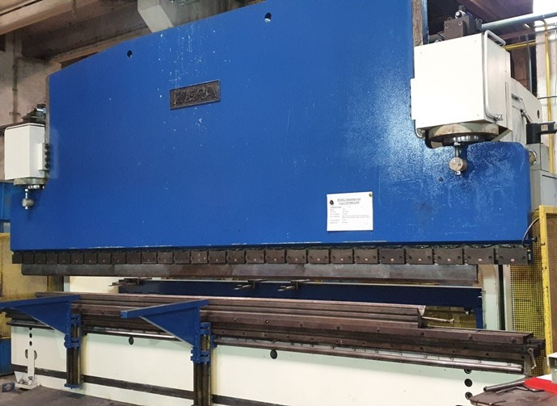
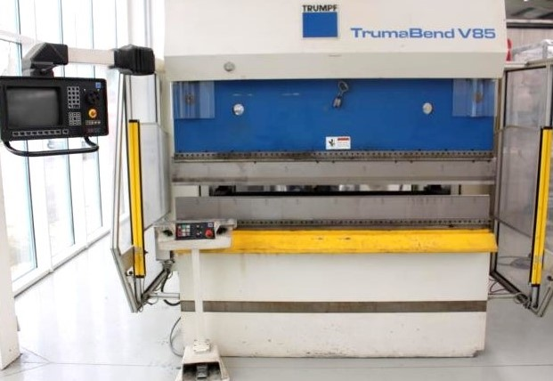
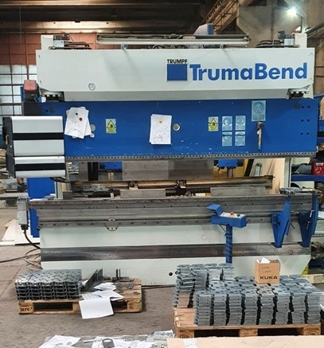
The bending department
1 press brake Trumph 85 tons 2 meters bending lenght
1 press brake Trumph 125 tons 3 meters bending lenght
1 press brake Hera 400 tons 6 meters bending lenght
2 sheet rolling machine:2 meters Thck 5 MM, 1.5 meters Thck 2 MM

Slide 5
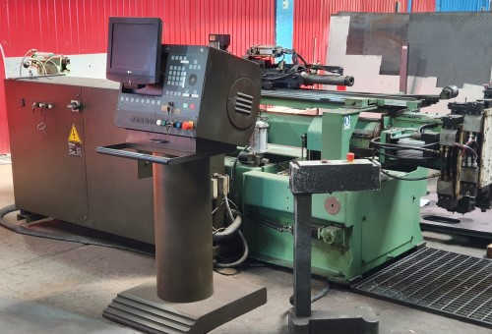
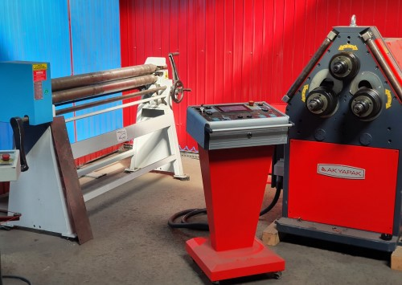
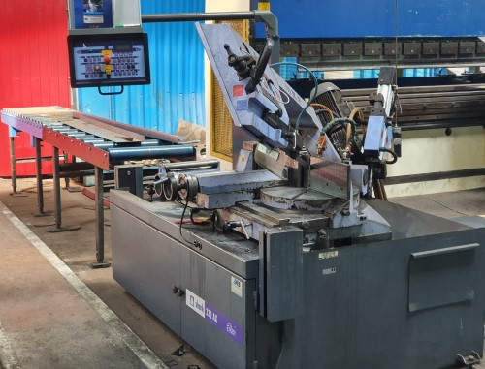
Tube bending and cutting
1 tube bending machine BLM: maximum tube diameter of 25 MM
1 tube rolling machine for pipes and profiles
1 automatic saw max dimesion 300 MM

Slide 6
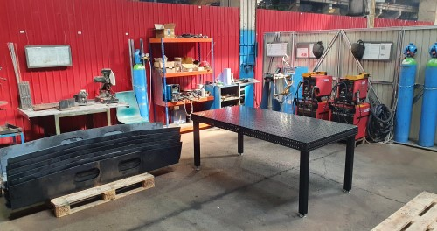
The welding department
3 welding machines Mig Mag and TIG-Wig
1 point welding
Our welding capacty encompasses: steel, stainless steel and galvanized
The welding team is equipped with profesional tooling (SIGMUND)

Slide 7
Painting and assembling
The painting, blasting and zinc coating is provided by subcontractors next to our facility
Painting by powder coating, blasting with sand and lead
The assembling also include all necessary processes like drilling, tapping, chamfering.....
Your finished product will be packed with great care to ensure a safe transport

Slide 8
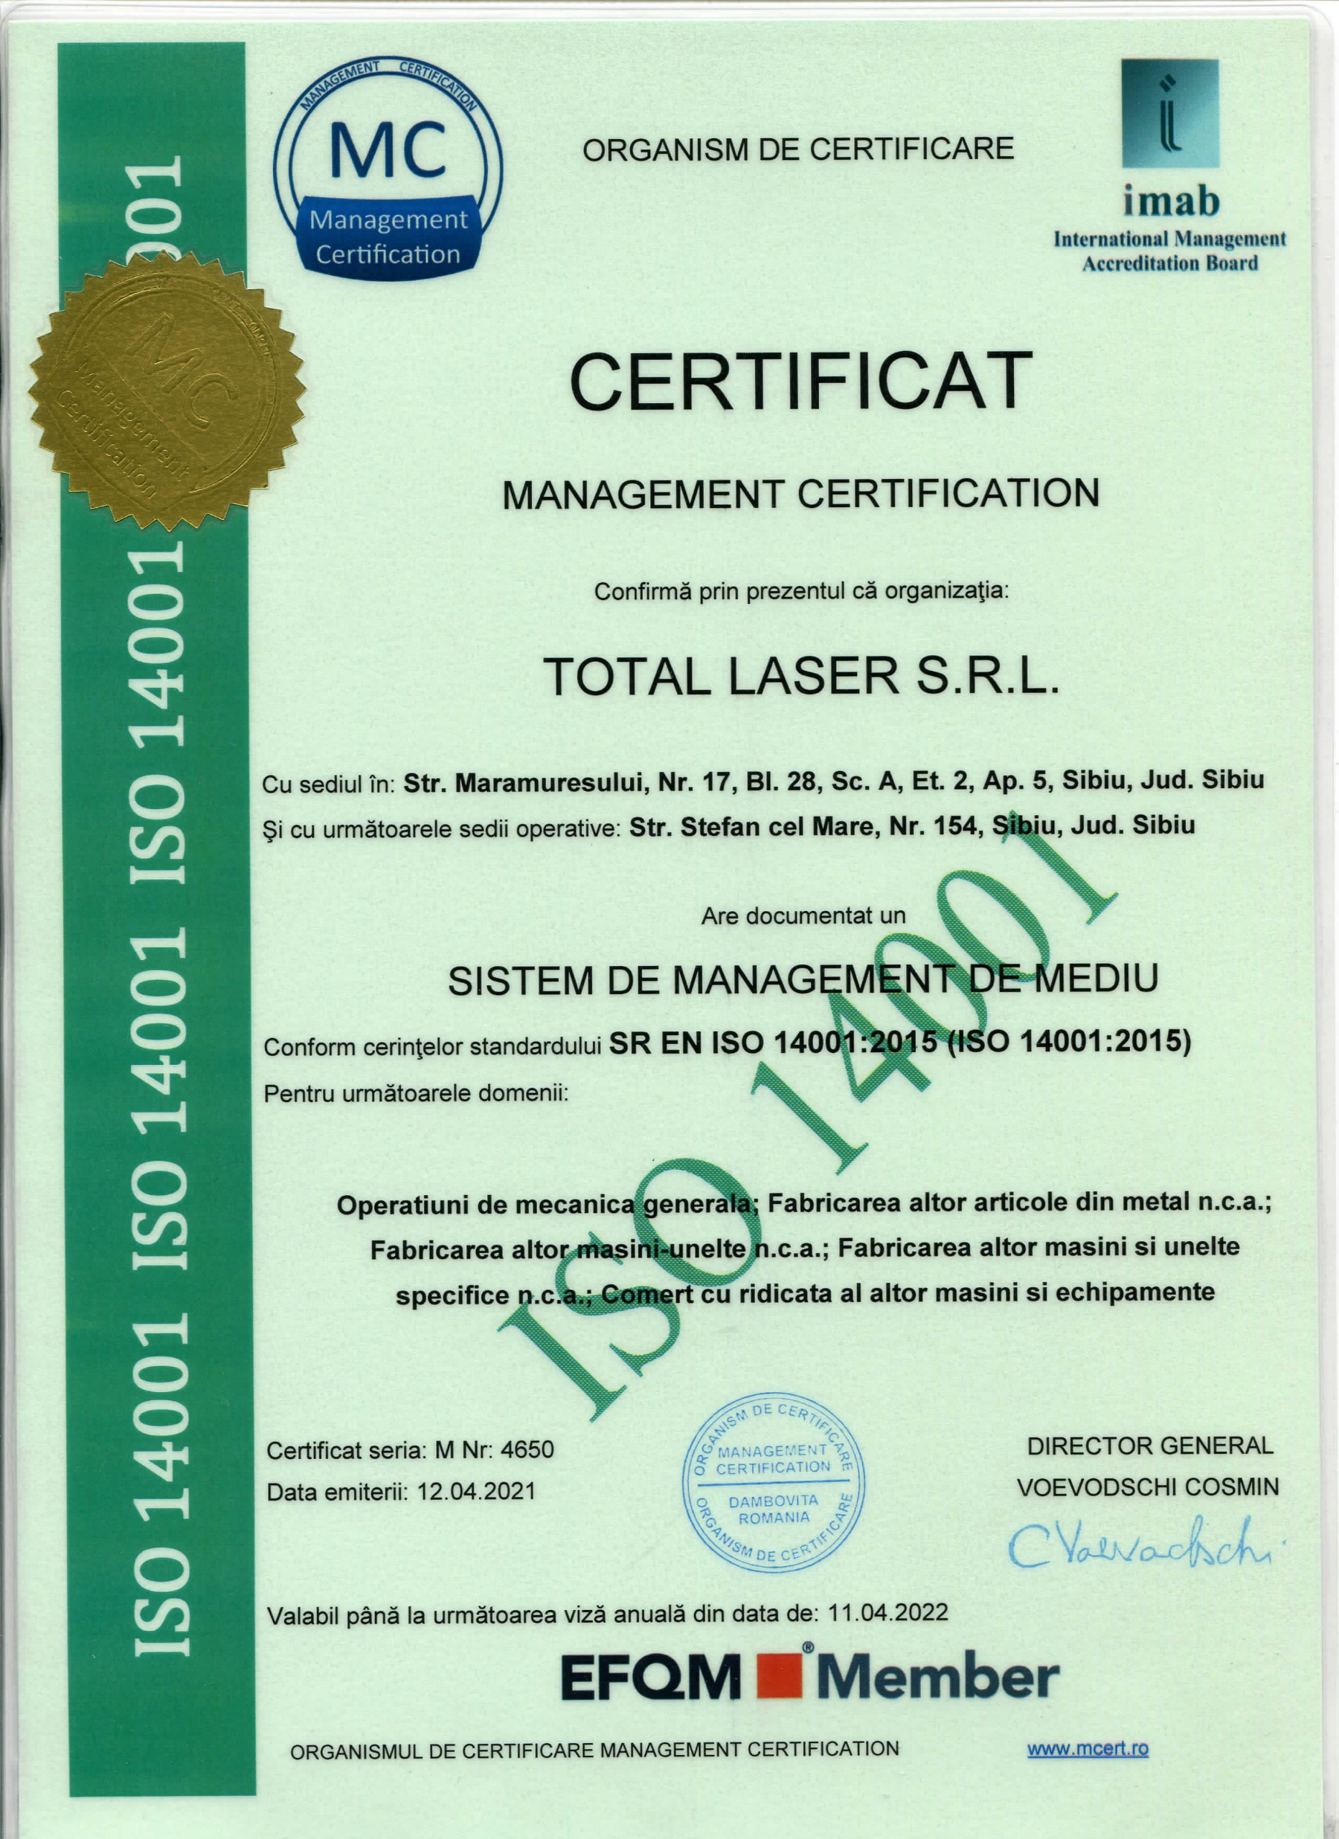
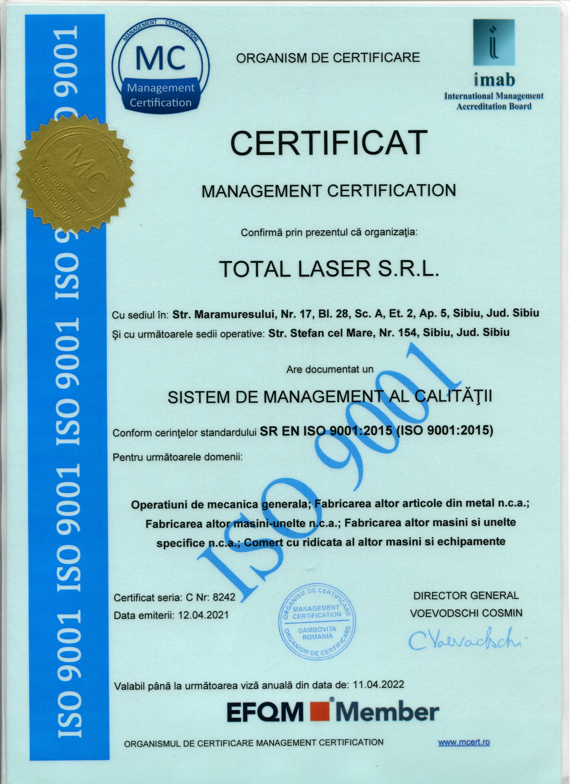
The quality control
Our company is ISO 9001 and ISO 14001 certified
All of our production is controlled by the quality control team in order to meet all your highest requirements

Slide 9
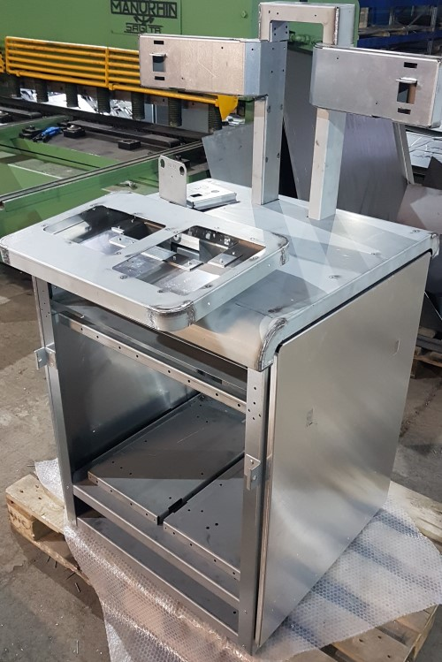
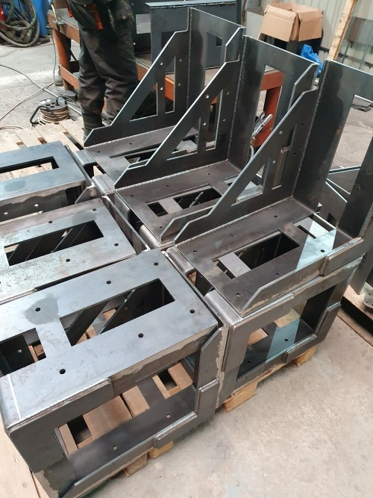
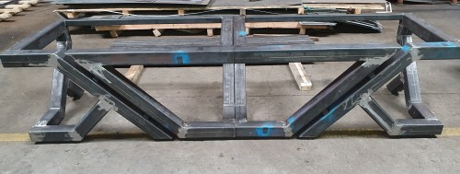
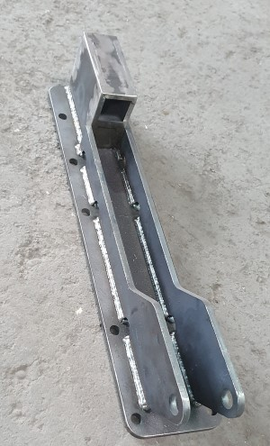
Our references
We are a well known company on the local sheet metal market
We are also working for international companies, our cutomers include: Siemens, Kuka, Walter GMBH, Guentner-Jaeggi, Loeser GMBH, Marquardt, Harting, Lisec, Cleanfix AG.

